Slide 1

Elementary Graph Algorithms
Submitted by:
Amrit Raj
181210008
CSE 2nd Year
Submitted to:
Chandresh Kumar Maurya

Slide 2
Contents
Representations
Breadth-First Search
Depth-First Search

Slide 3
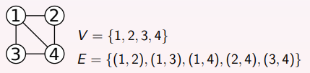
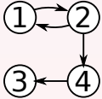
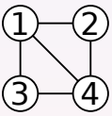
Representation
A graph G = (V, E) is a pair of sets.
V is a finite set of vertices.
E ⊆ V × V is a set of edges.
Two types of graph:
Directed Graph Undirected Graph

Slide 4
Representation
Two common ways to represent a (directed or undirected) graph are:
Adjacency Lists
Adjacency Matrix
In the following, assume that V = {1,2,3, . . . ,n}.

Slide 5
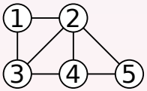
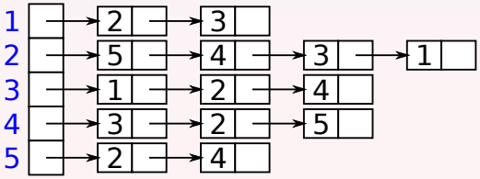
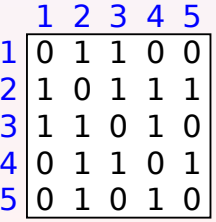
Representation
Graph
Representation in Adjacency List
Representation in Adjacency Matrix

Slide 6
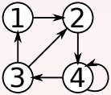
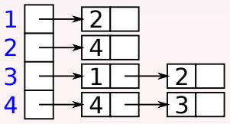
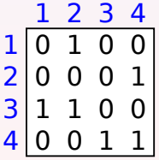
Representation
Representation in Adjacency List
Representation in Adjacency Matrix

Slide 7
Breadth-First Search(BFS)
Given a graph G = (V, E) and a vertex v, the BFS algorithm computes the following information.
The vertices that are reachable from s.
The shortest distance from s to each reachable vertex.
A shortest paths tree that allows reporting the shortest path from s to a reachable vertex.

Slide 8
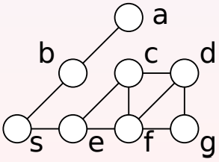
Breadth-First Search
The main idea is:
Find the vertices that have distance 1 from s.
Find the vertices that have distance 2 from s.
Find the vertices that have distance 3 from s.
etc.
Distance:……0………1………2…………3

Slide 9
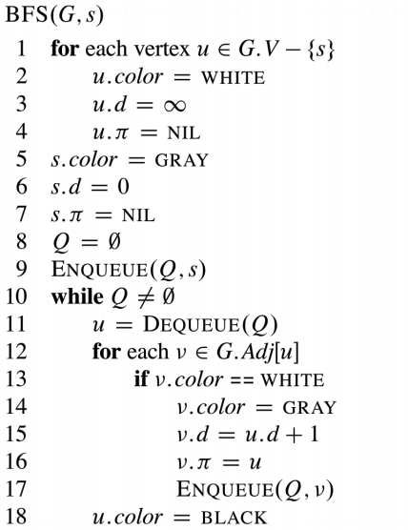
Breadth-First Search Algorithm
Time Complexity
If G is represented using adjacency lists, the time complexity of BFS is Θ(V + E):
Lines 1–4 take Θ(V) time.
Lines 7–9 take Θ(1) time.
Lines 10–11 and 14–18 take O(V) time.
Lines 12–13 take O( P u∈V |Adj[u]|) = O(E) time.

Slide 10
Depth-First Search
The main idea is
Start from some vertex of the graph.
At each step, try to move to an unvisited neighbour of the current vertex.
If no such neighbour exists, perform backtracking.
After visiting all the vertices that are reachable from the initial vertex, repeat this process from an unvisited vertex.

Slide 11
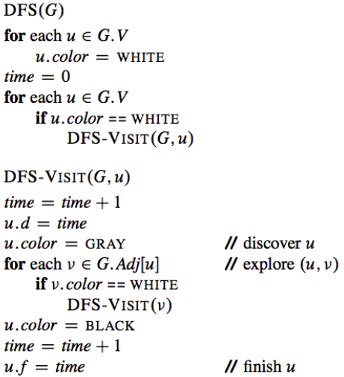
Depth-First Search Algorithm
Time Complexity
If G is represented using adjacency lists, the time complexity of DFS is Θ(V + E).

Slide 12
END OF SLIDES
THANK YOU

